Slide 1
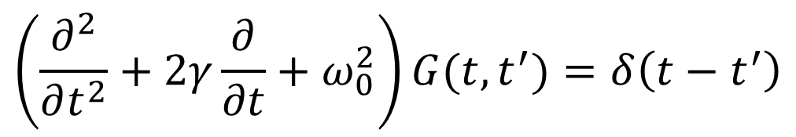
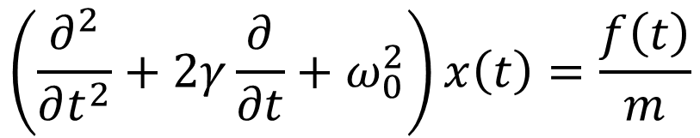

Green’s function
$$\left(\frac{∂^{2}}{∂t^{2}}+2γ\frac{∂}{∂t}+ω_{0}^{2}\right)x\left(t\right)=\frac{f\left(t\right)}{m}$$
$$\left(\frac{∂^{2}}{∂t^{2}}+2γ\frac{∂}{∂t}+ω_{0}^{2}\right)G(t,t^{′})=δ\left(t−t^{′}\right)$$
$$x\left(t\right)=\int_{−∞}^{t}{G}(t,t^{′})f\left(t^{′}\right)dt^{′}$$

Slide 2
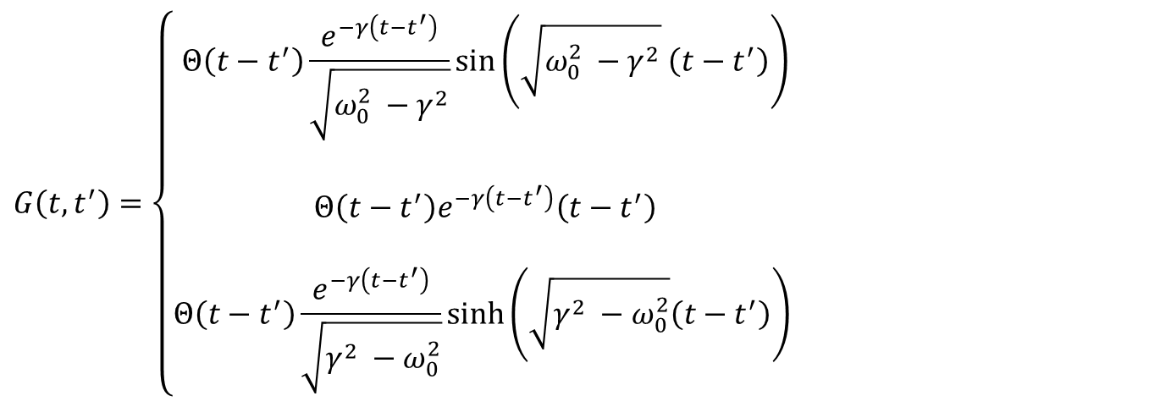




Solution
$$x\left(t\right)=\int_{−∞}^{t}{G}(t,t^{′})f\left(t^{′}\right)dt^{′}$$
$$G\left(t,t^{′}\right)=\left\{\begin{aligned}Θ\left(t−t^{′}\right)\frac{e^{−γ\left(t−t^{′}\right)}}{\sqrt{ω_{0}^{2} −γ^{2}}}\sin\left(\sqrt{ω_{0}^{2} −γ^{2}} \left(t−t^{′}\right)\right) \\ \\ Θ\left(t−t^{′}\right)e^{−γ\left(t−t^{′}\right)}\left(t−t^{′}\right) \\ \\ Θ\left(t−t^{′}\right)\frac{e^{−γ\left(t−t^{′}\right)}}{\sqrt{γ^{2} −ω_{0}^{2}}}\sinh\left(\sqrt{γ^{2} −ω_{0}^{2}}\left(t−t^{′}\right)\right) \end{aligned}\right.$$
$$ω_{0}>γ$$
$$ω_{0}=γ$$
$$ω_{0}<γ$$

Slide 3
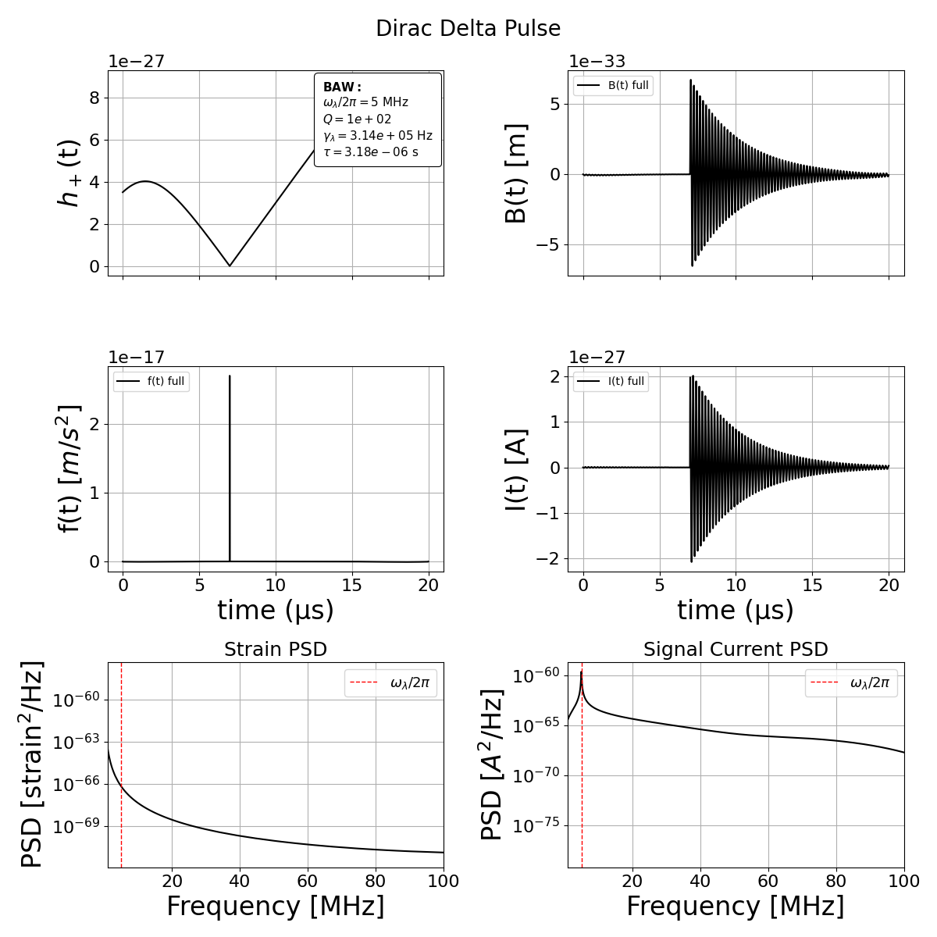

$$Q={10}^{2}$$

Slide 4
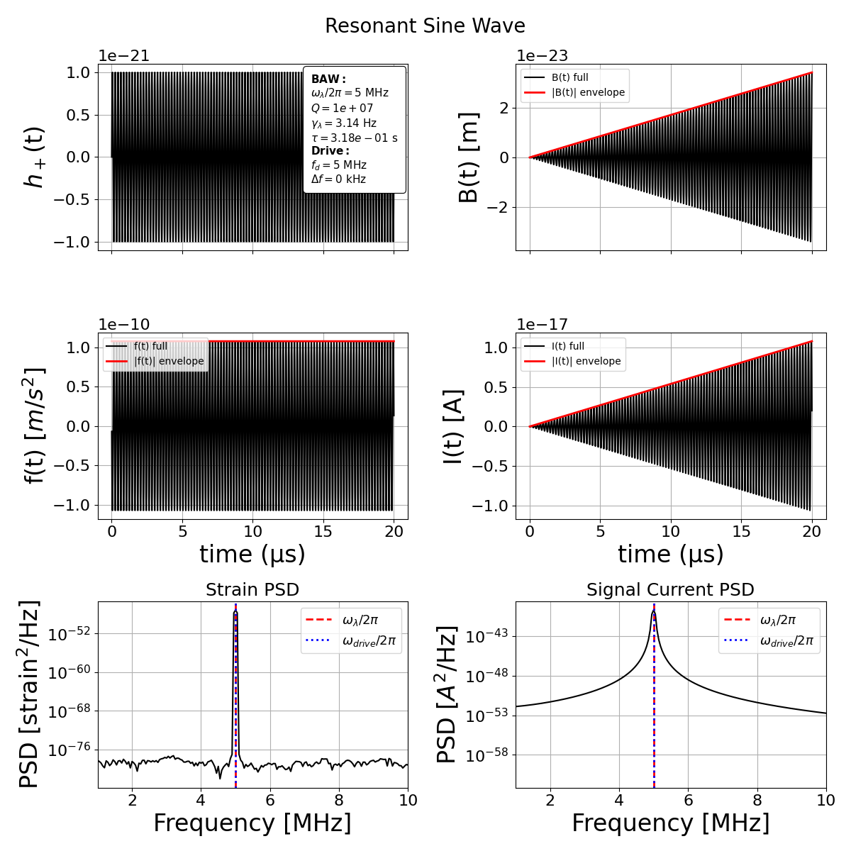
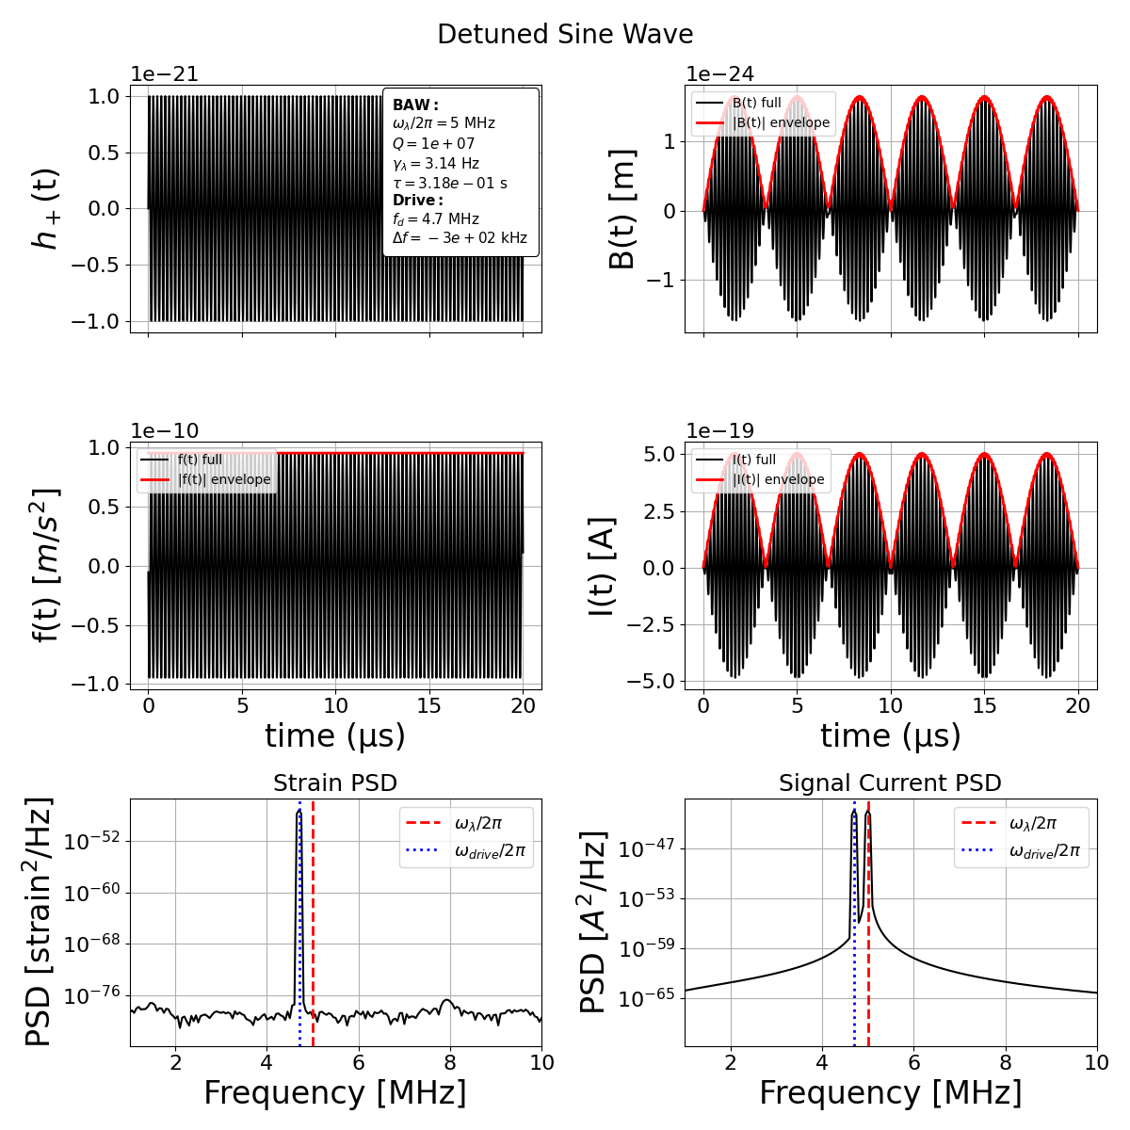

$$Q={10}^{7}$$

Slide 5
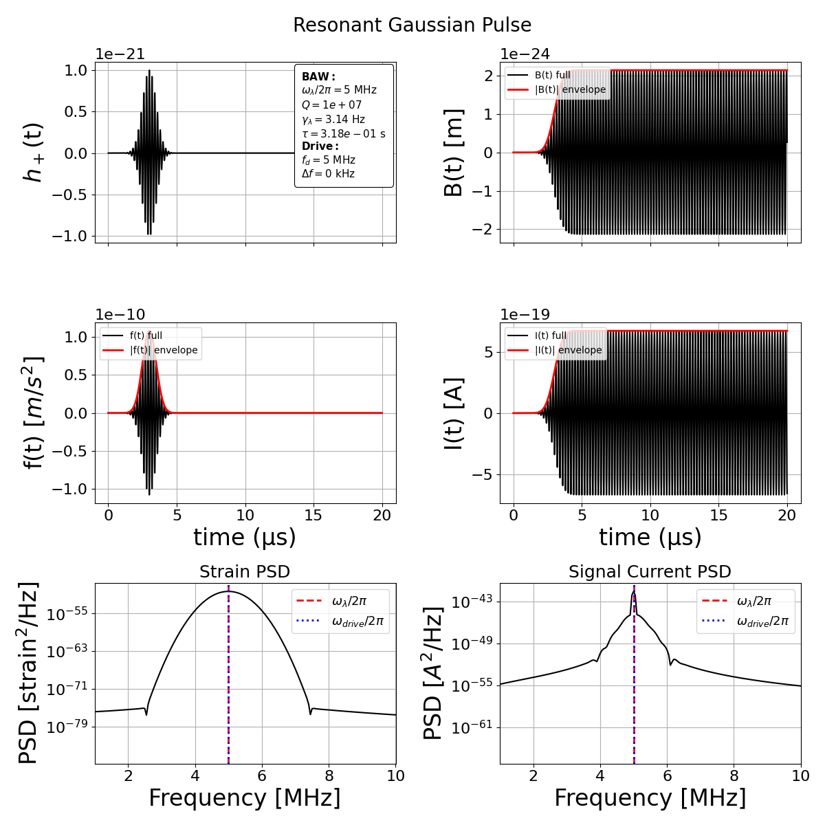
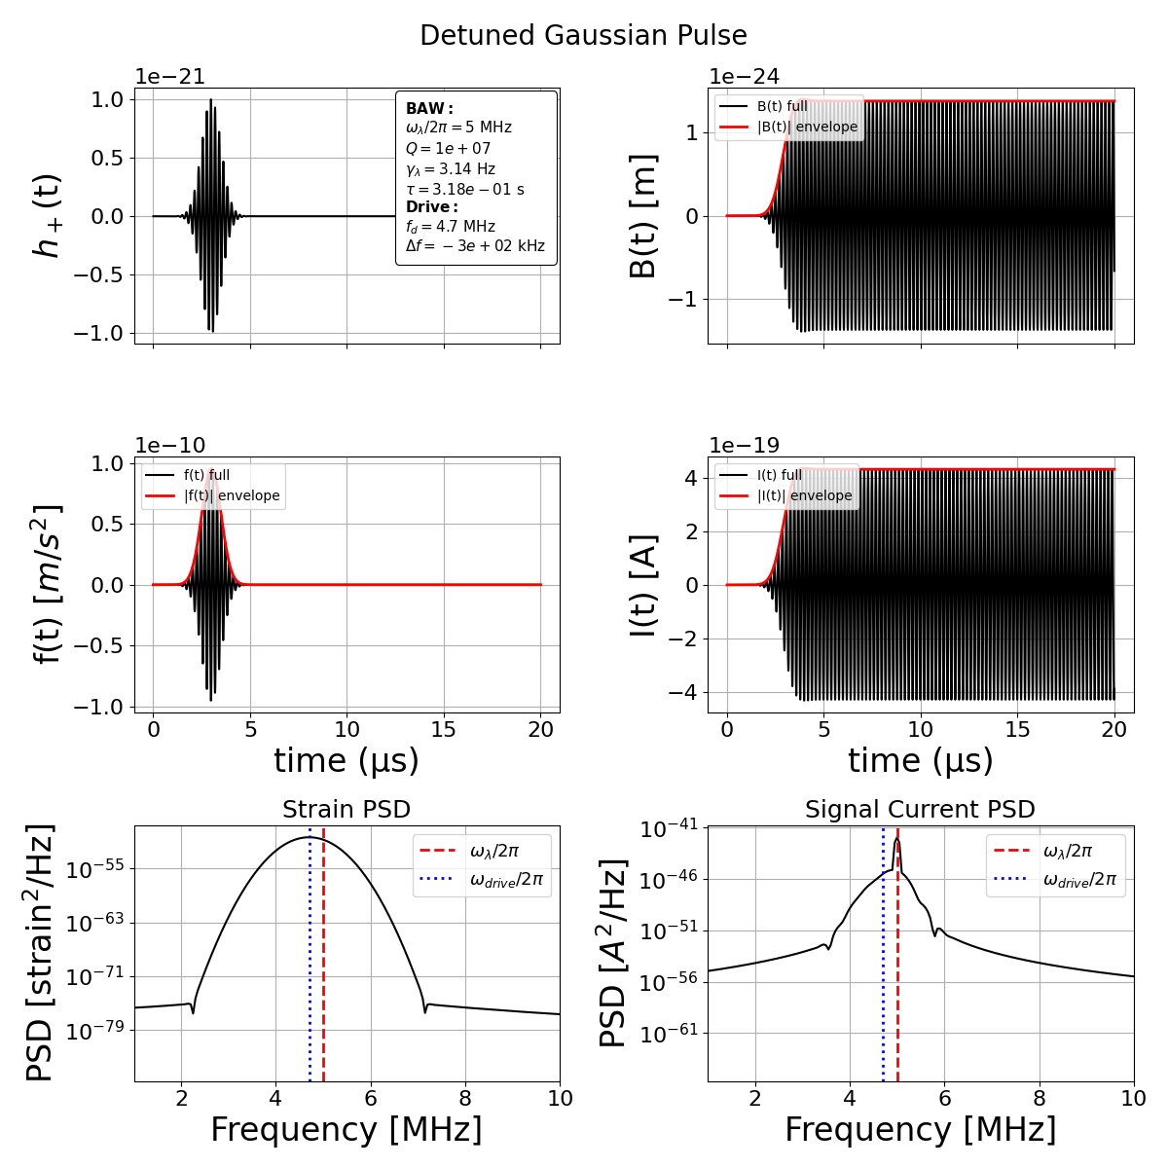
$$Q={10}^{7}$$

Slide 6
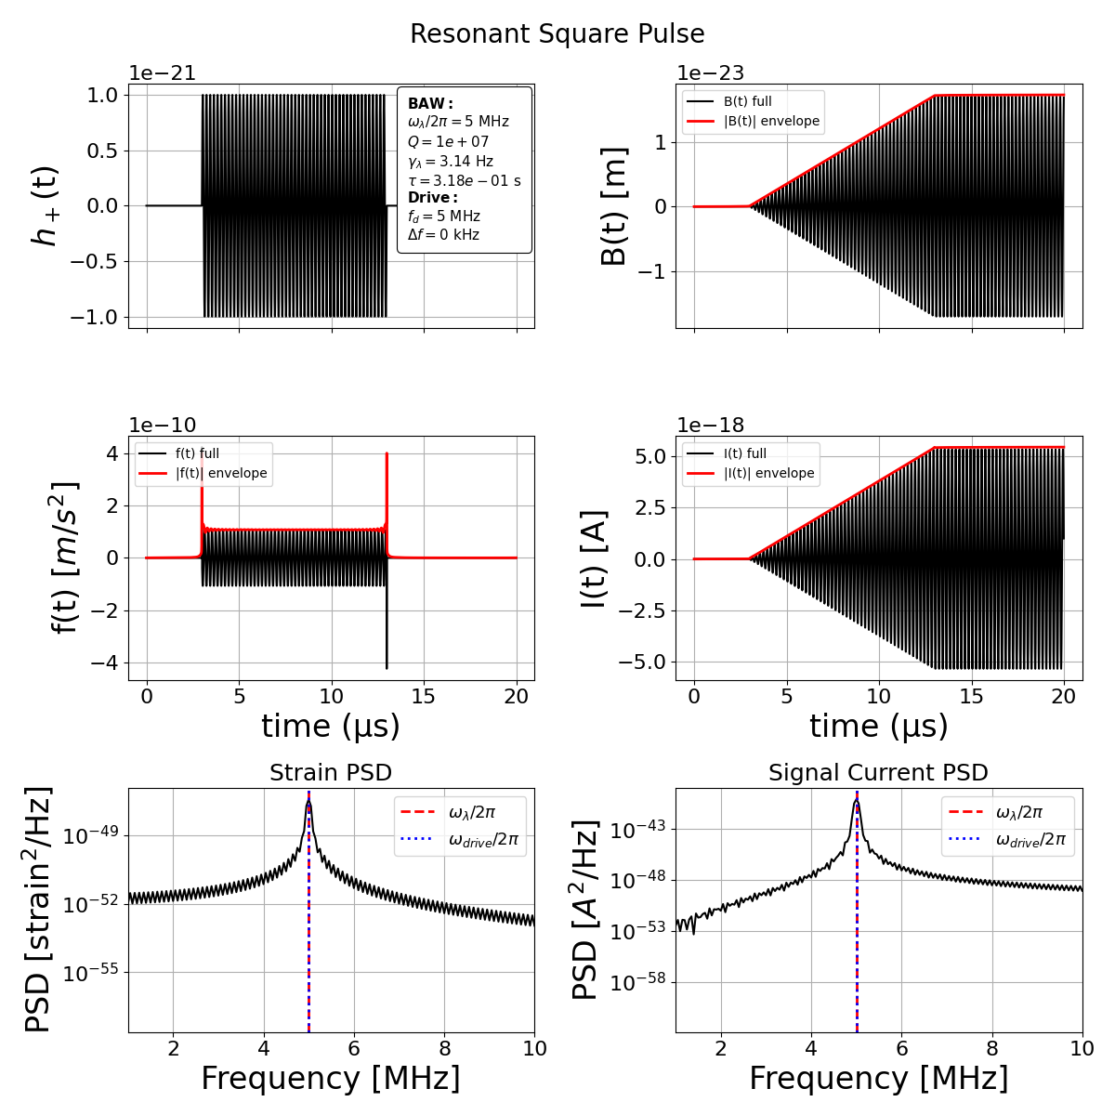
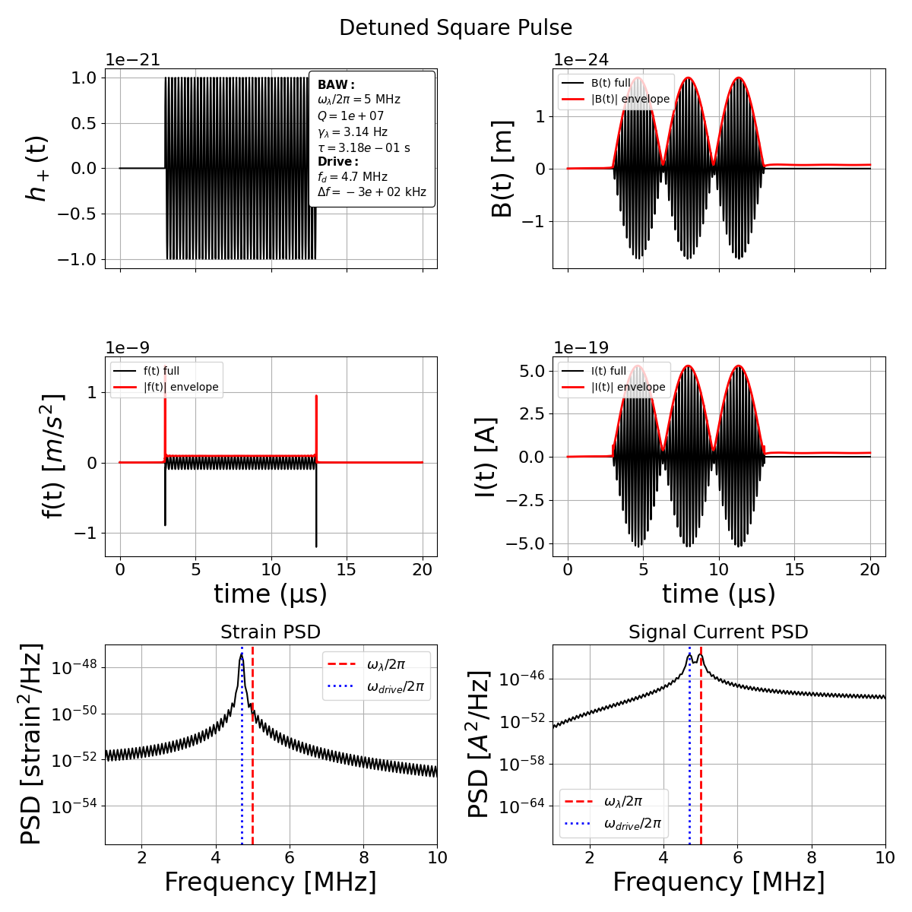
$$Q={10}^{7}$$

Slide 7
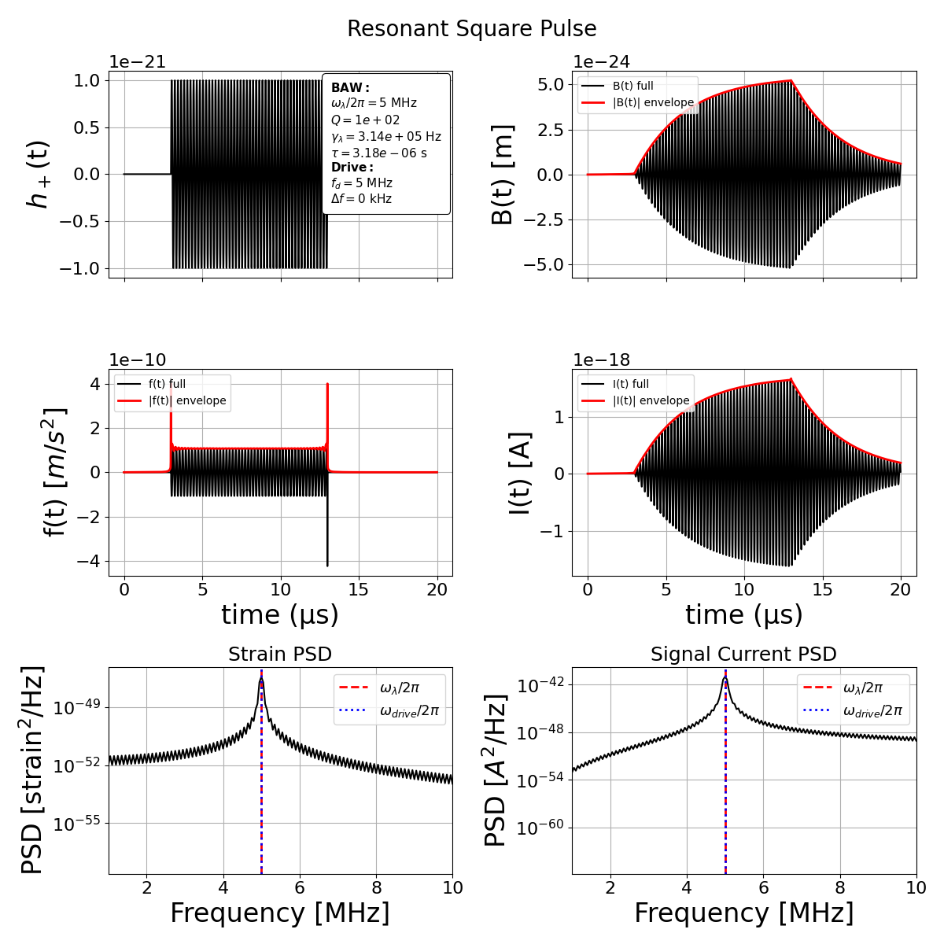
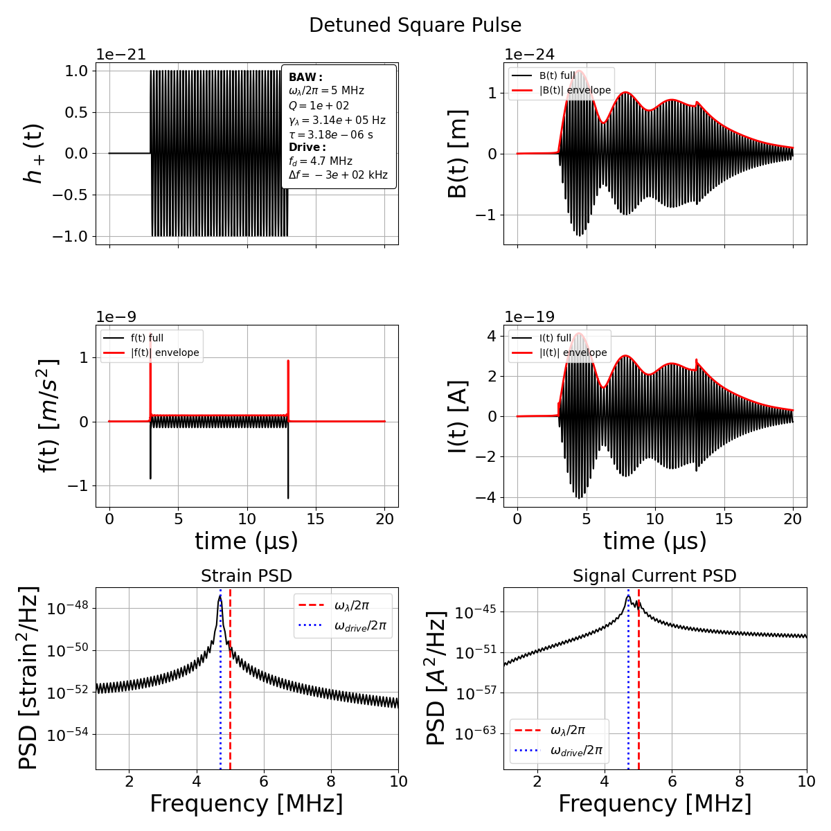
$$Q={10}^{2}$$

Slide 8
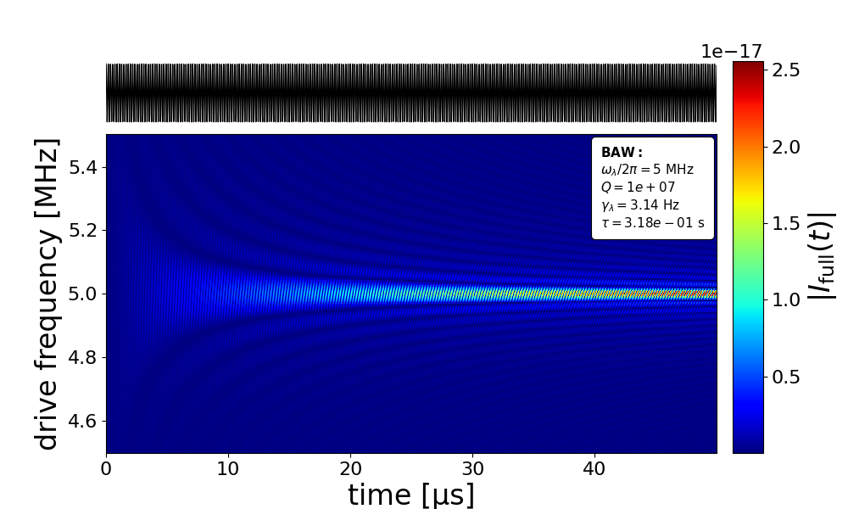
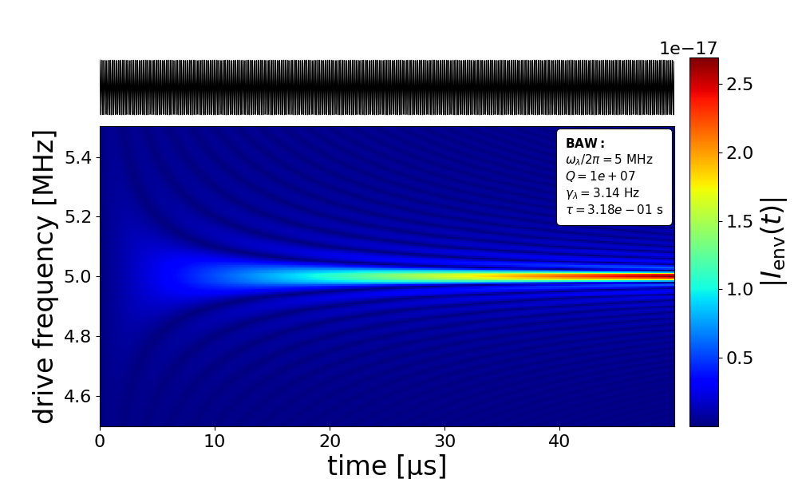
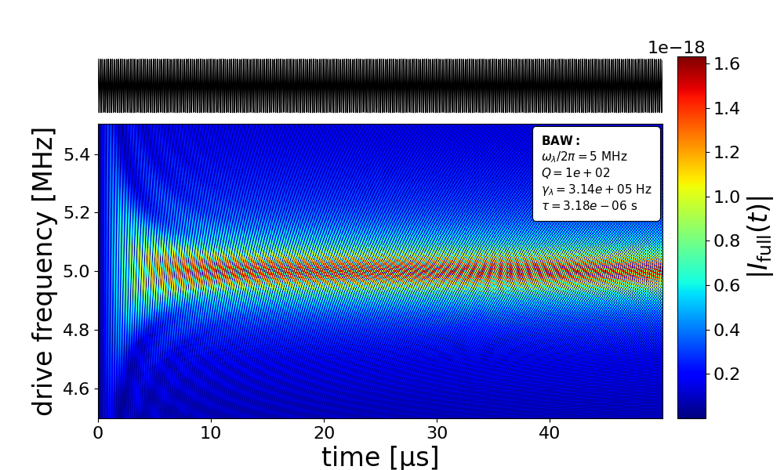
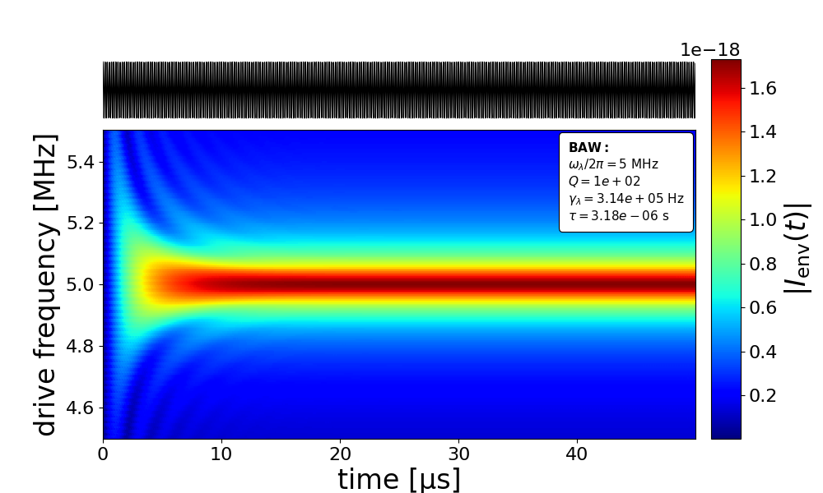
Full Green’s solution
Envelope solution
Strain
Strain
High Q
Strain
Strain
Low Q

Slide 9
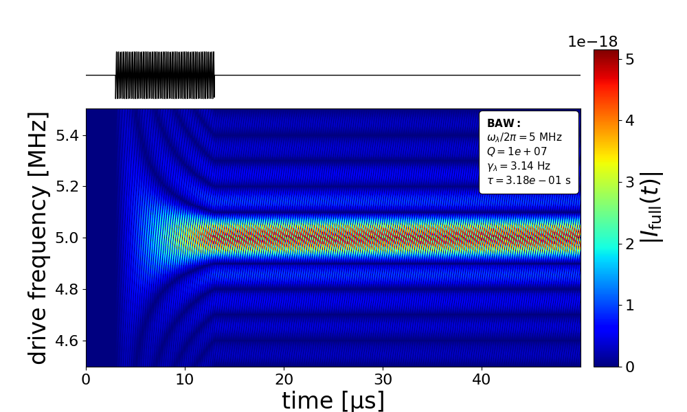
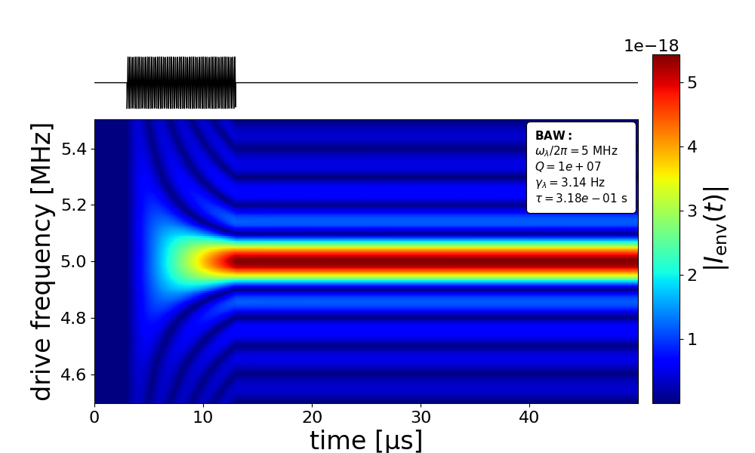
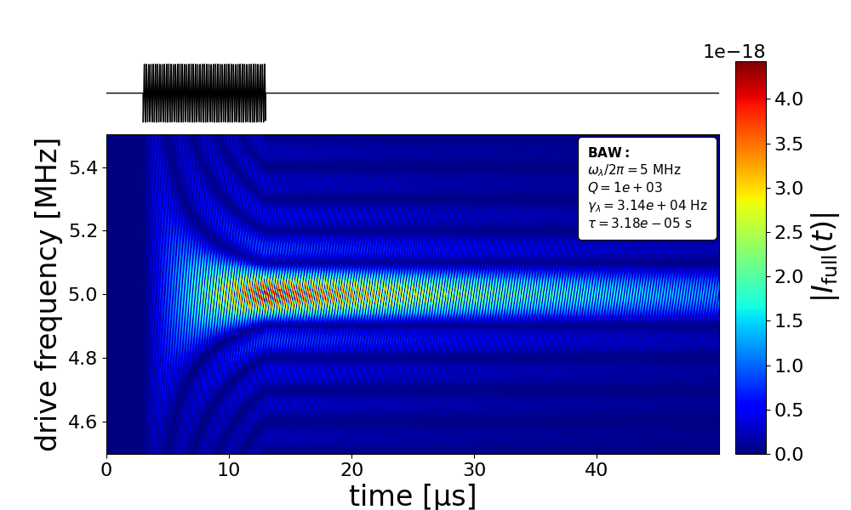
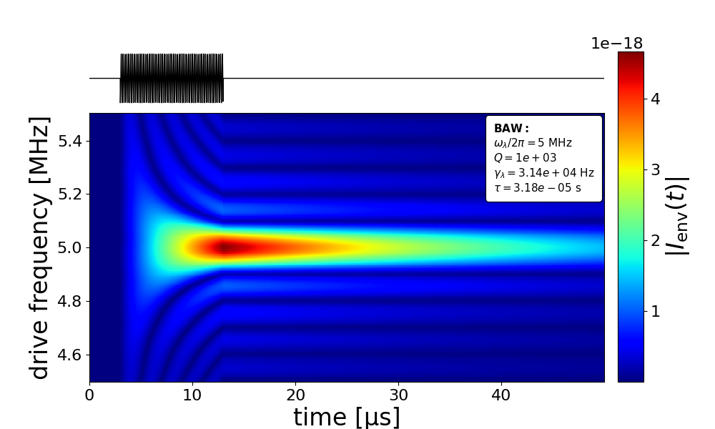
Full Green’s solution
Envelope solution
Strain
Strain
High Q
Strain
Strain
Low Q

Slide 10
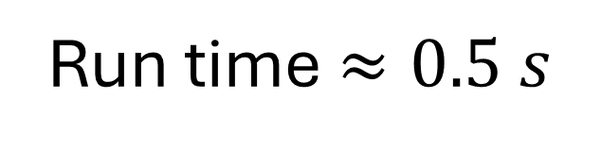
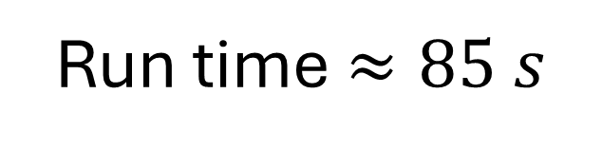
Full Green’s solution
Envelope solution
Full Green’s solution
Envelope solution
Strain
Strain
High Q
Run time $≈85 s$
VS
Run time $≈0.5 s$
Strain
Strain
200x
Speed-up
Low Q

Slide 11
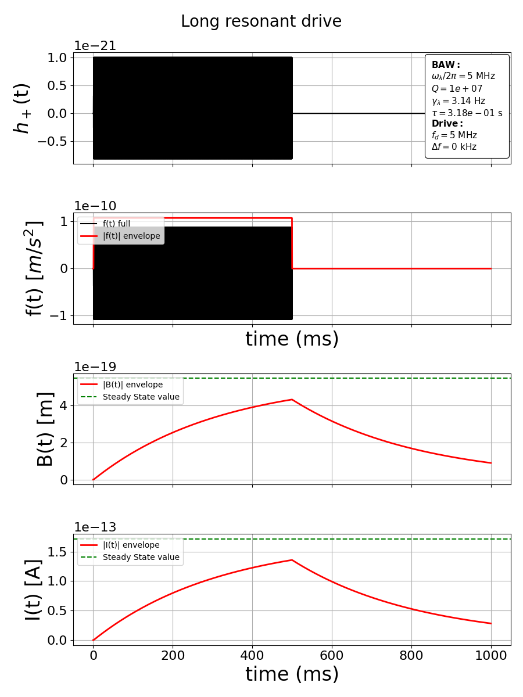
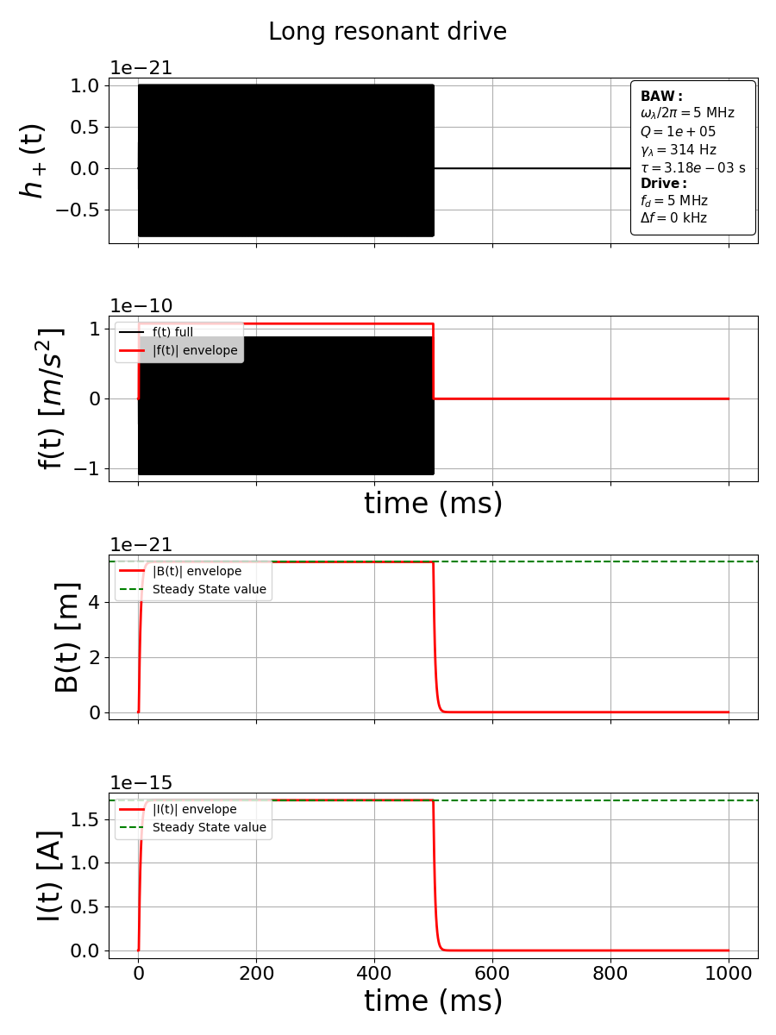
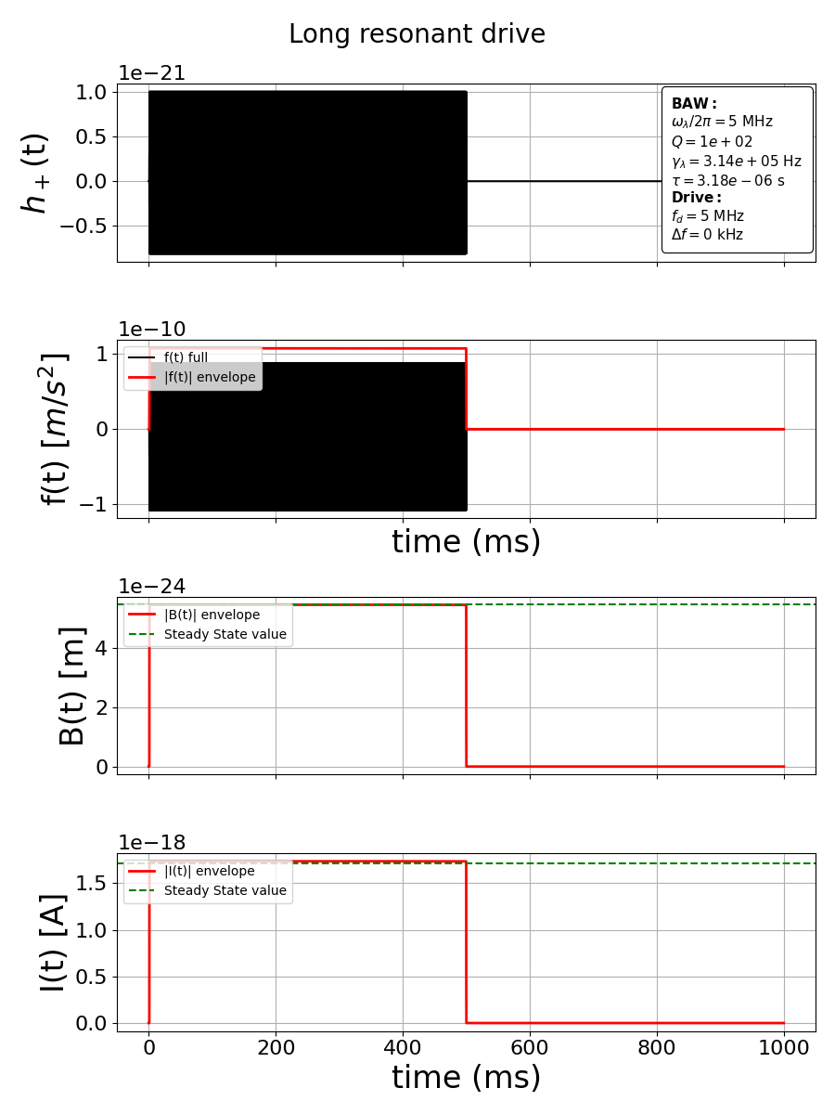


$$B_{steady state}[m]=\frac{1}{2ω_{λ}γ_{λ}}\max\left(f\left(t\right)\right)$$
$$I_{steady state}[m]=\frac{k_{λ}}{2γ_{λ}}\max\left(f\left(t\right)\right)$$

Slide 12
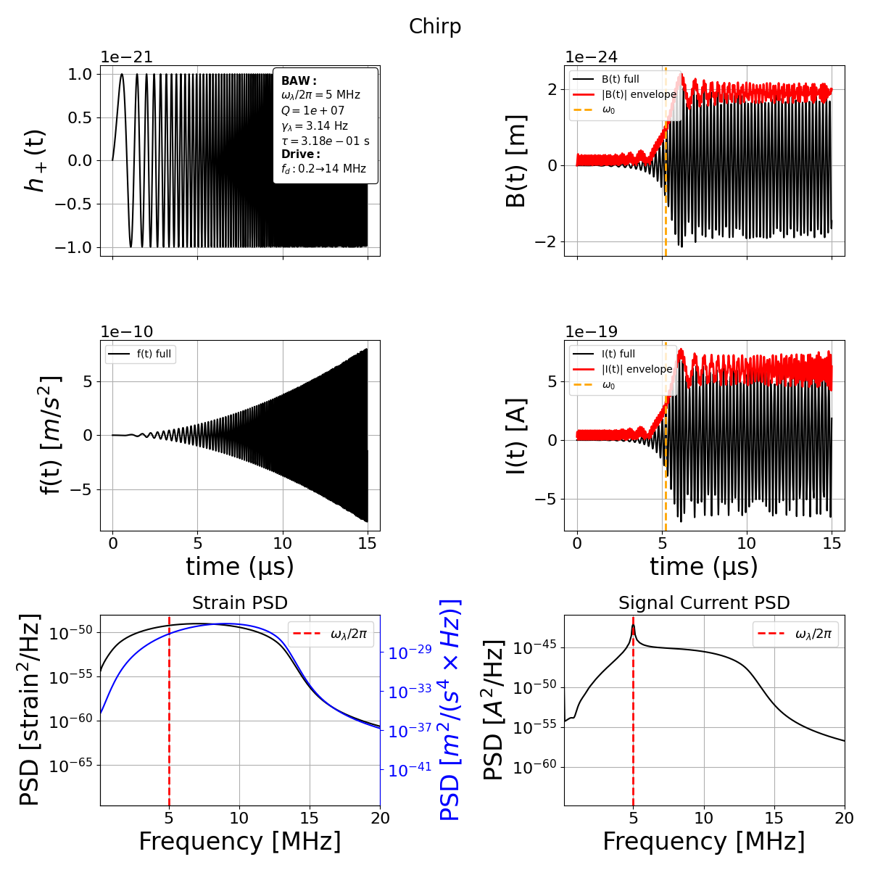
Chirp Signal

Slide 13


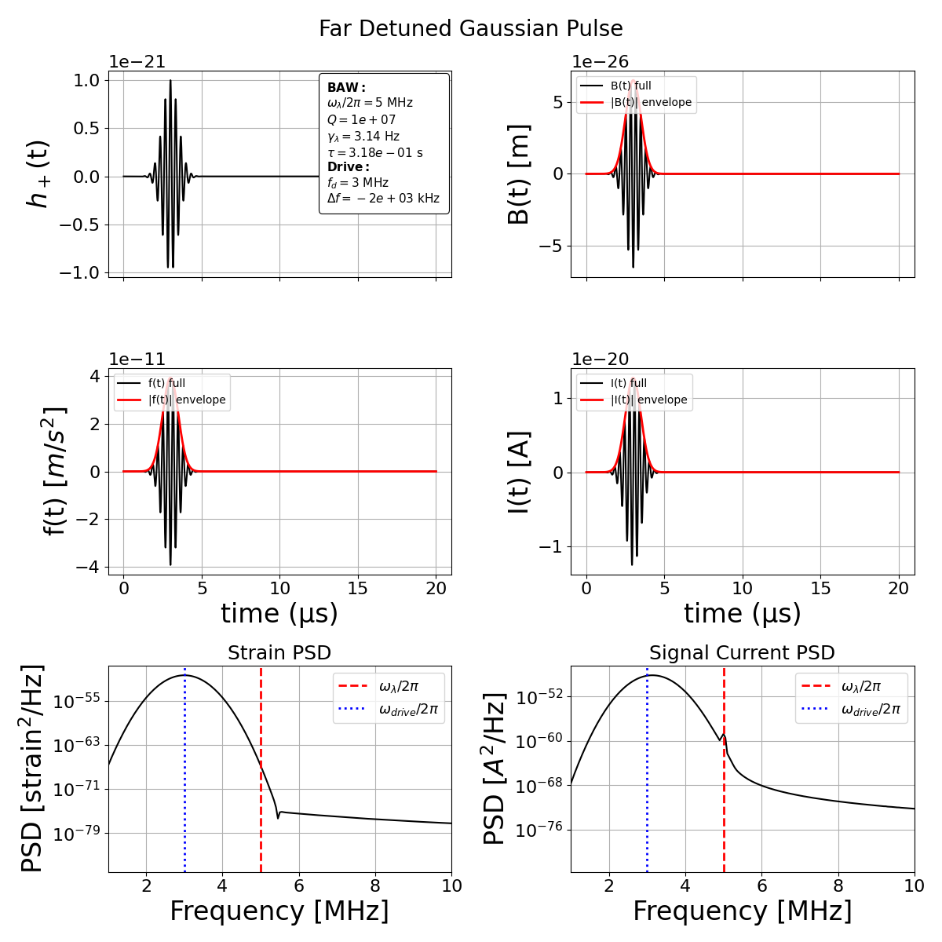

Slide 14
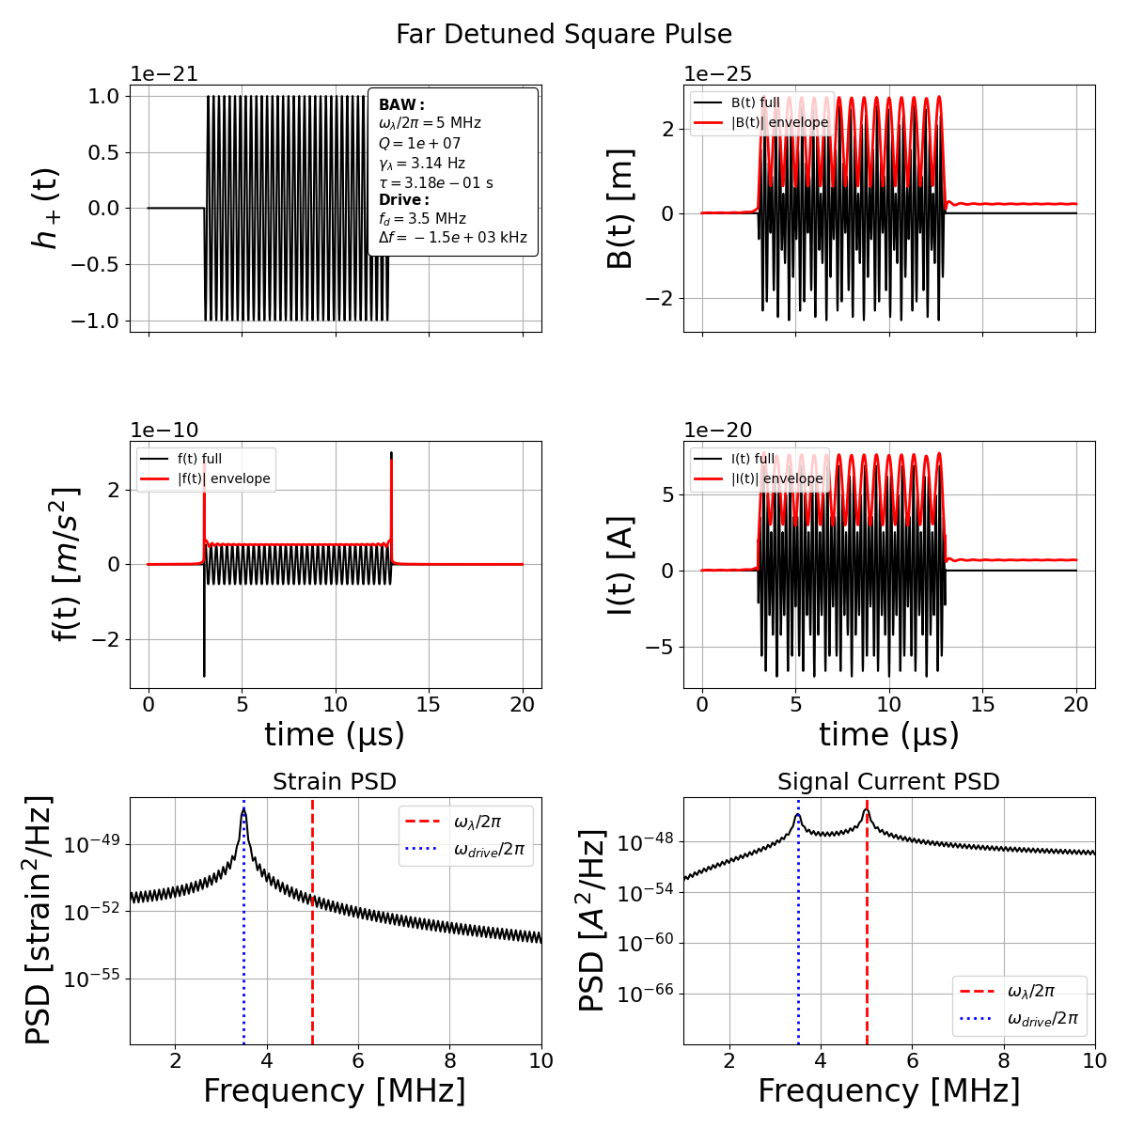

Slide 15


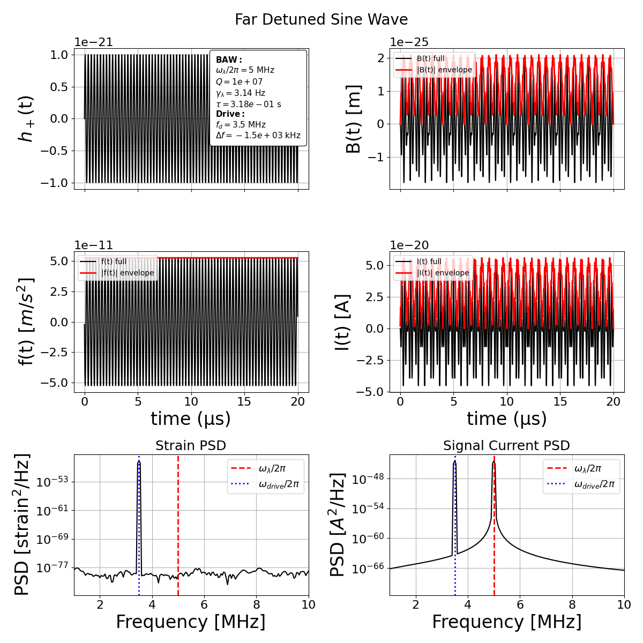

Slide 16
Backup slides

Slide 17
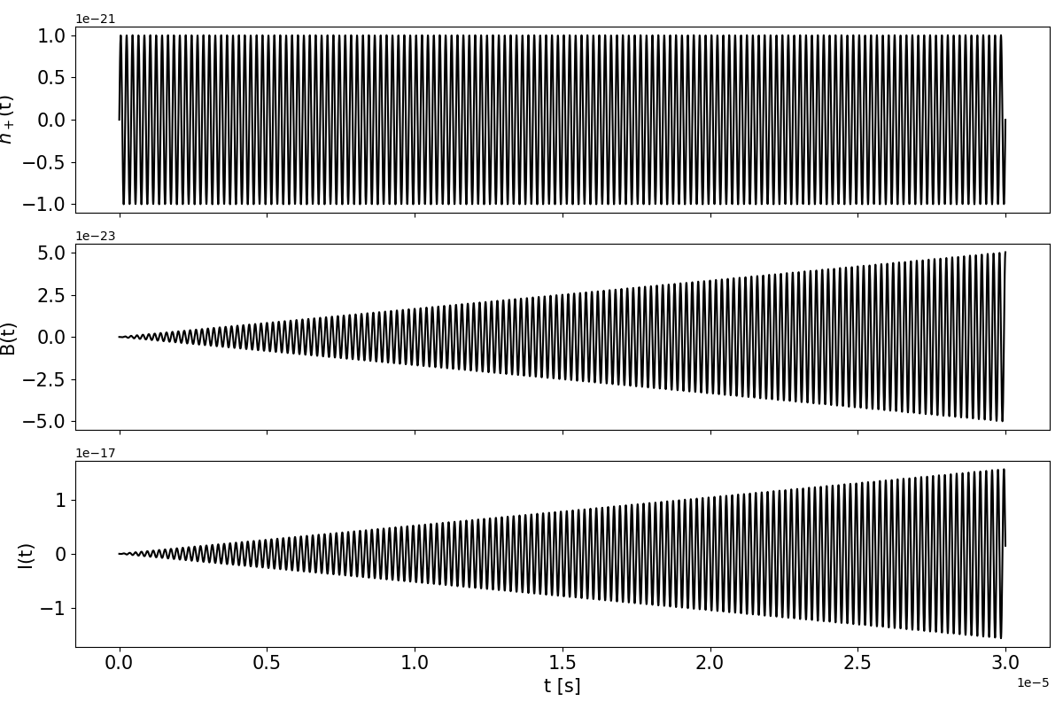
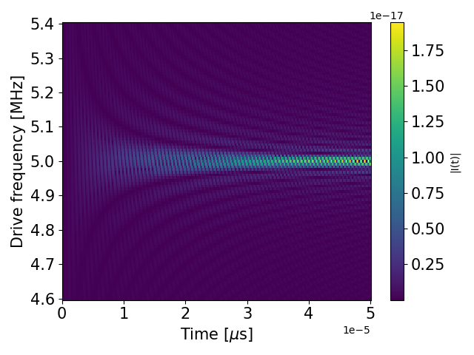

$$ω_{m}=2π×5 MHz− Q={10}^{7}$$
$$ω_{d}=2π×5 MHz$$

Slide 18
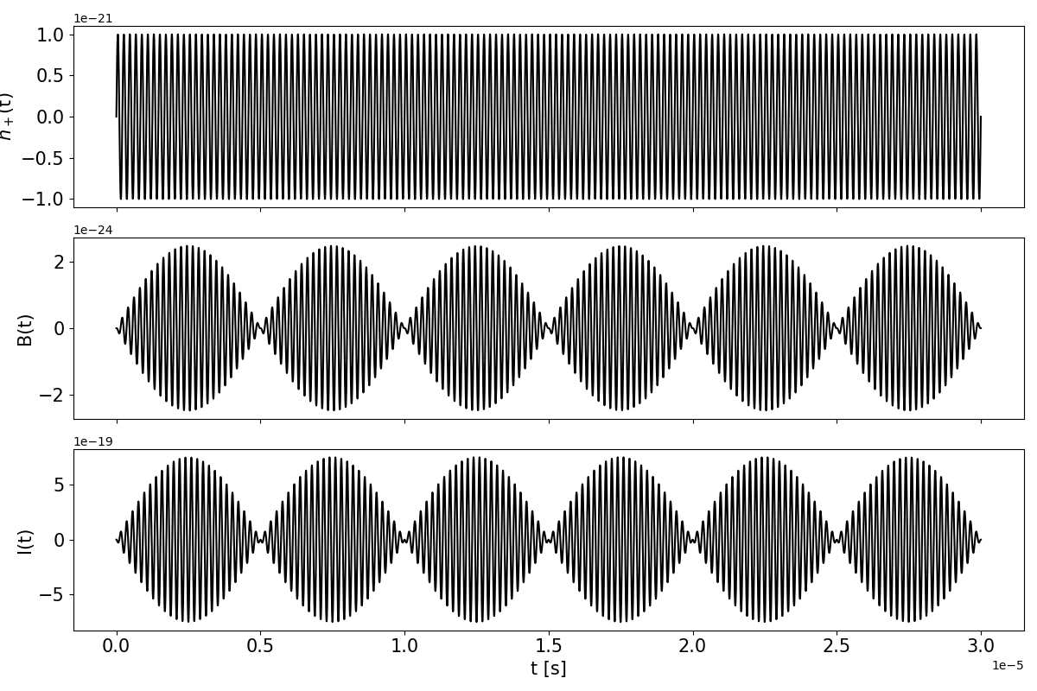
$$ω_{m}=2π×5 MHz− Q={10}^{7}$$
$$ω_{d}=2π×4.8 MHz$$

Slide 19
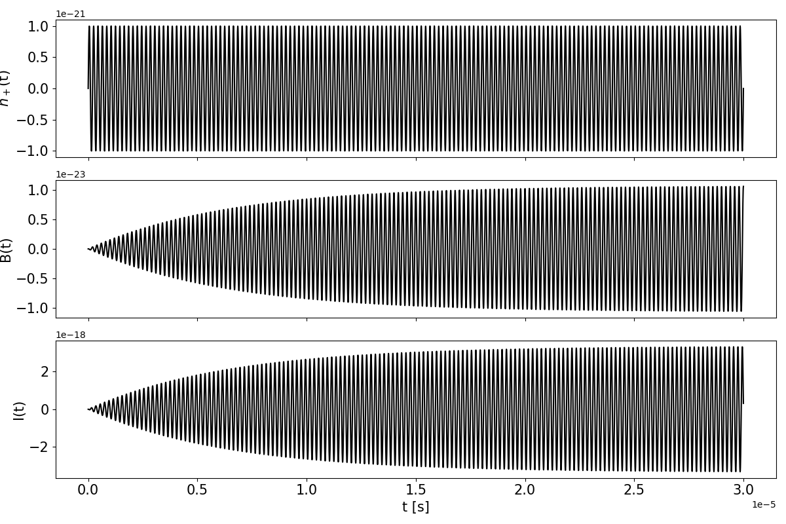
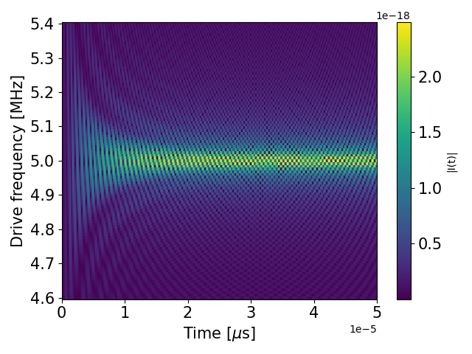

$$ω_{m}=2π×5 MHz− Q={10}^{2}$$
$$ω_{d}=2π×5 MHz$$

Slide 20
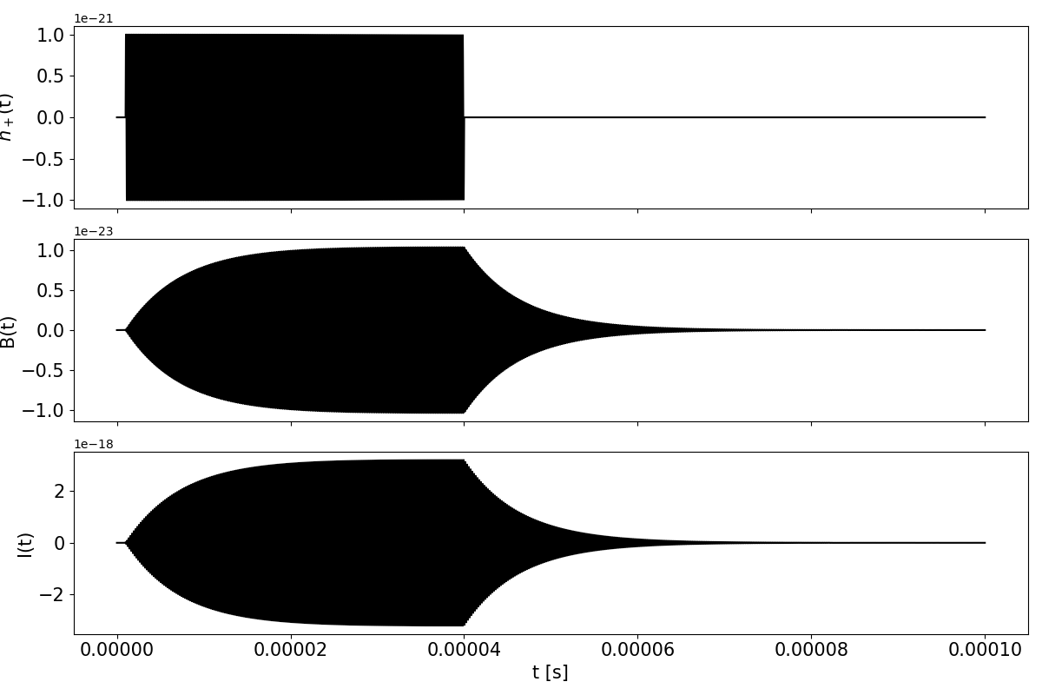
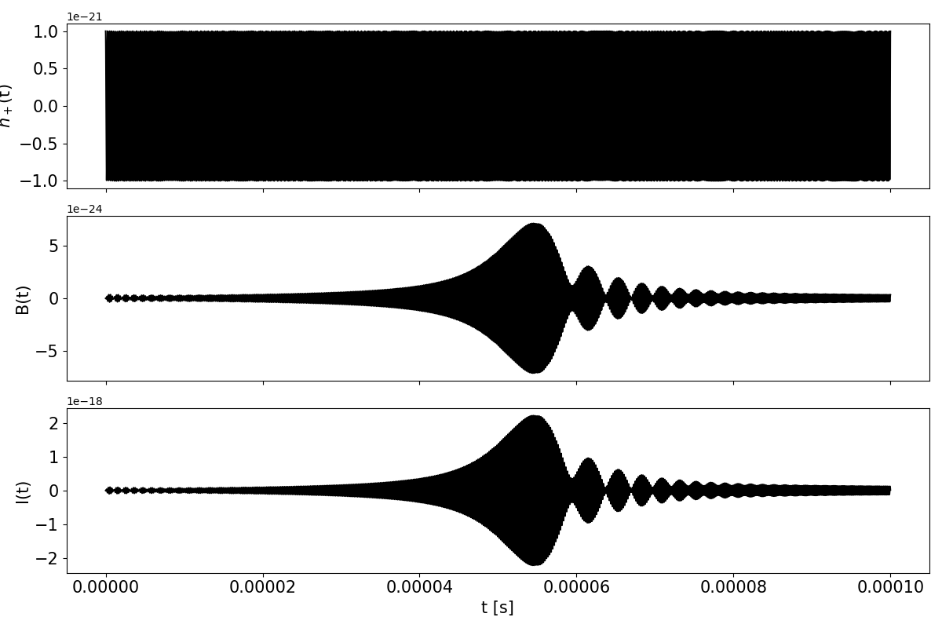

$$ω_{m}=2π×5 MHz − Q={10}^{2}$$

